Slide 1

City of Kaufman
FY 22 Budget Public Hearing
September 13, 2021

Slide 2
Historical Taxable Values
1.4%
11.8%
7.0%
22.1%
12.5%
Certified
10.1%
6-year increase
83.5%
11.1% AVG

Slide 3
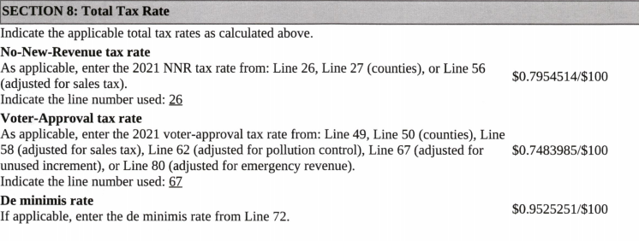
Calculated Tax Rates

Slide 4
$.7999760
$.0993926
Taxable Value 2021 - $ 543,249,171
Taxable Value 2020 - $ 493,523,810
Increase in Value - $ 49,725,361
10.1% Increase in Taxable Value
$ increase in property tax Revenue in this budget vs. last year’s budget $ 202,035
$84,821 – Property Tax Revenue raised from New Property added to the Tax Roll ($10,669,668 taxable value).
Tax Roll Value Breakdown
60% Residential
40% Commercial/Industrial/Utilities

Slide 5
Proposed Tax Rate
$.799976
$.5010896 (O&M)
$2,423,537
$.3205864 (I&S)
$1,550,526
$.493172 (O&M)
$2,625,572
$.3068036 (I&S)
$1,633,374
Current $3,974,063
Proposed $4,232,327
O&M - $202,035
I&S - $ 82,849
TOTAL - $284,884

Slide 6
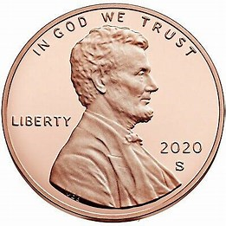
Proposed FY22 Tax Rate
Total Tax Rate Decrease = $.0217
Total Tax Rate = $.799976

Slide 7
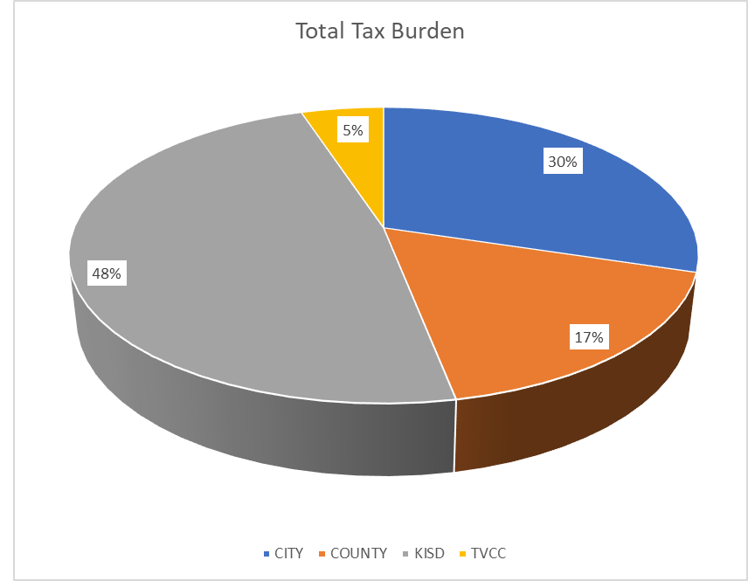
Total Tax Rate Breakdown
C
Co
KISD
TVCC
C
Co
KISD
TVCC

Slide 9
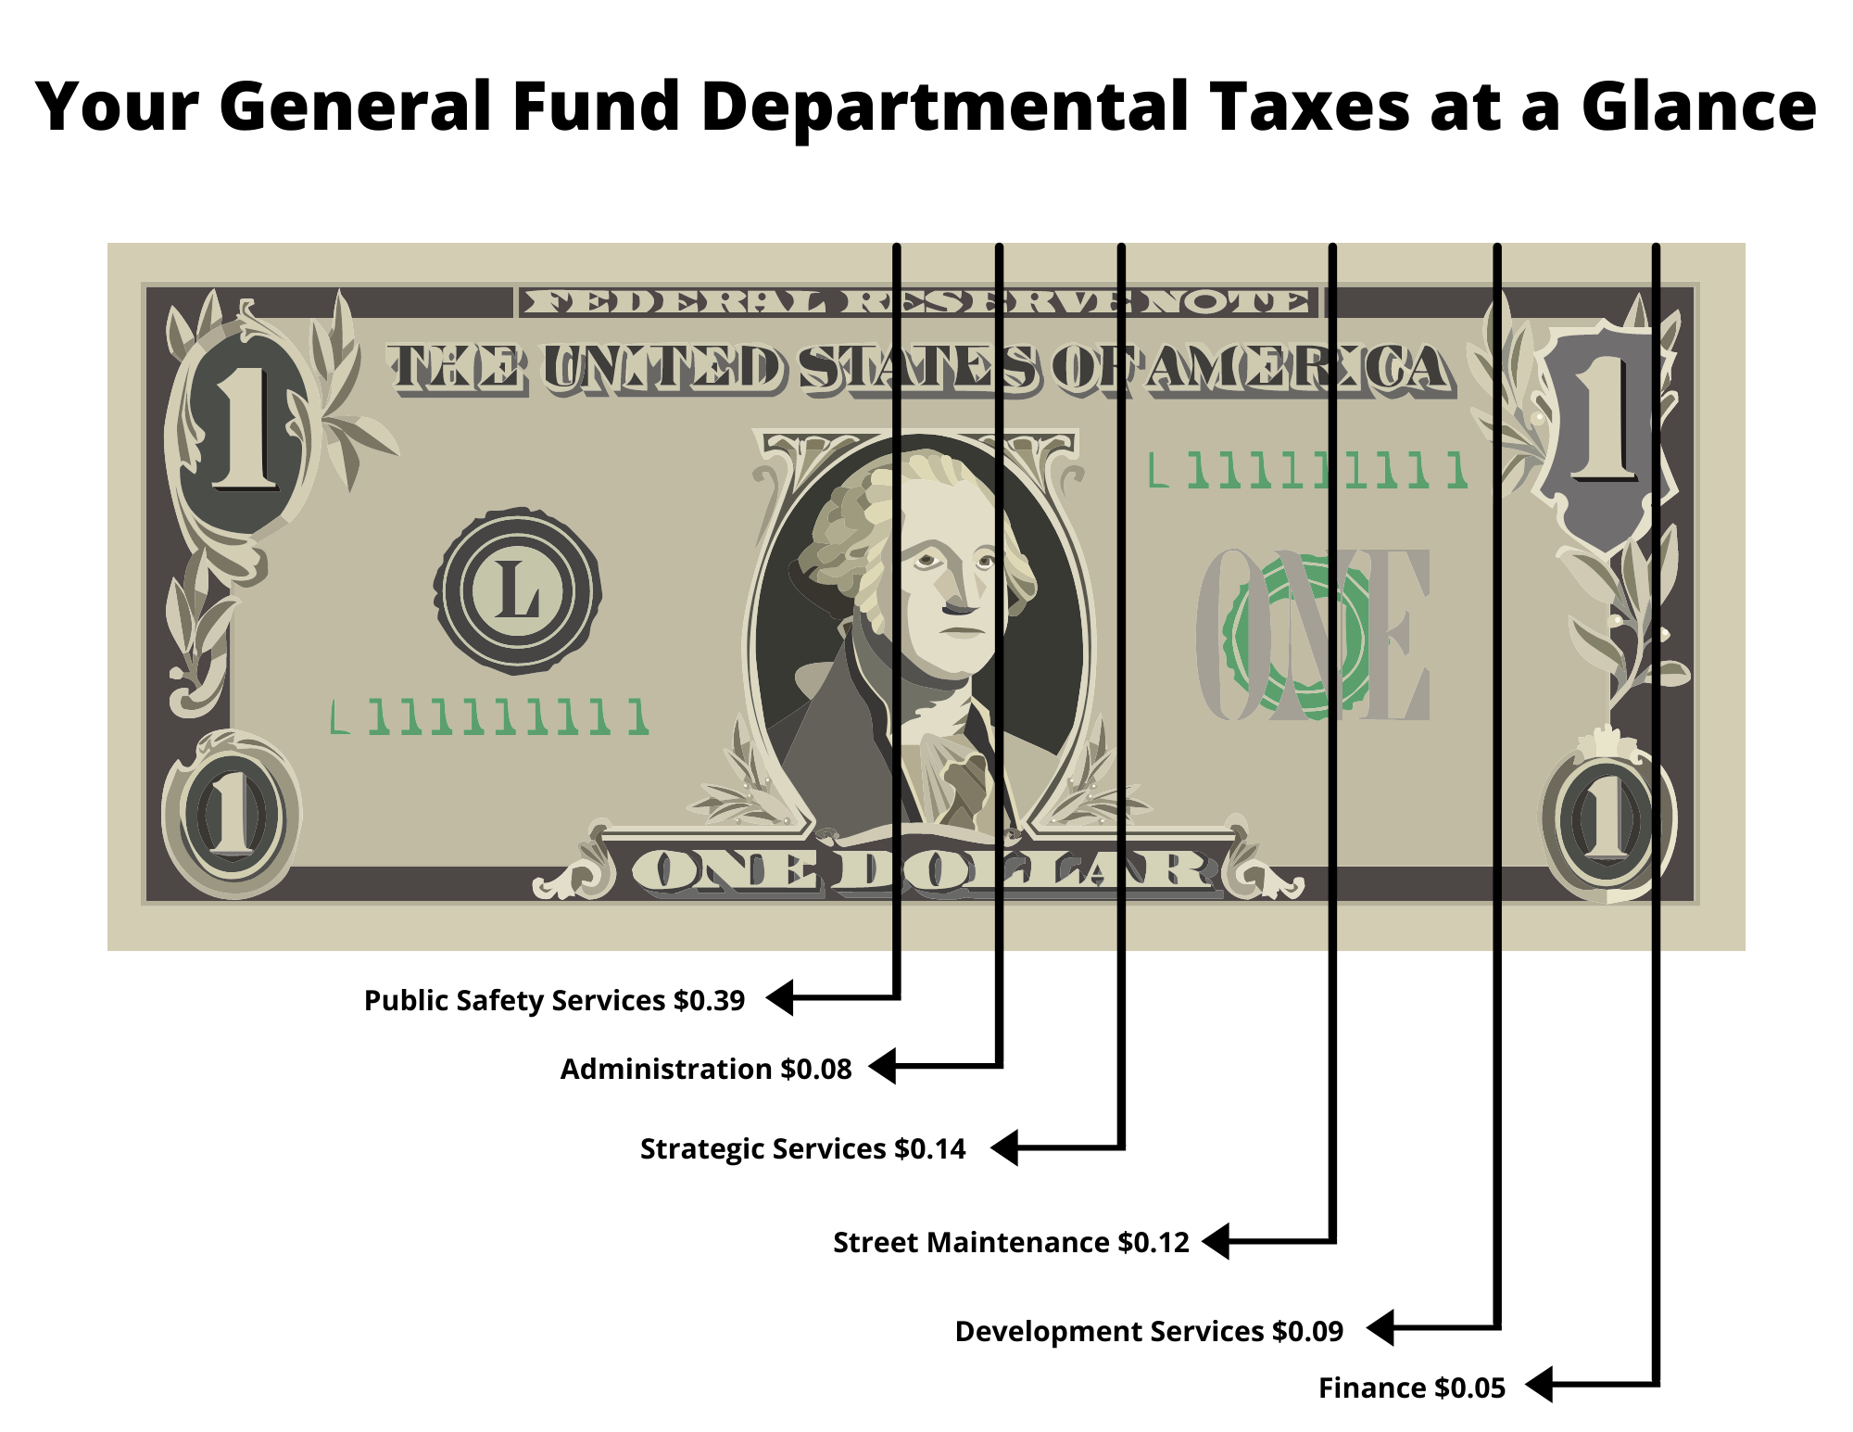
$1 Bill Graphic

Slide 10
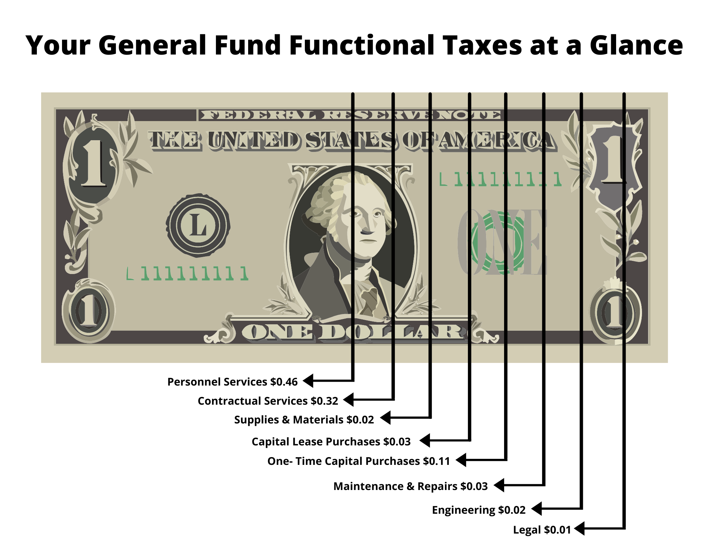
$1 Bill Graphic

Slide 11
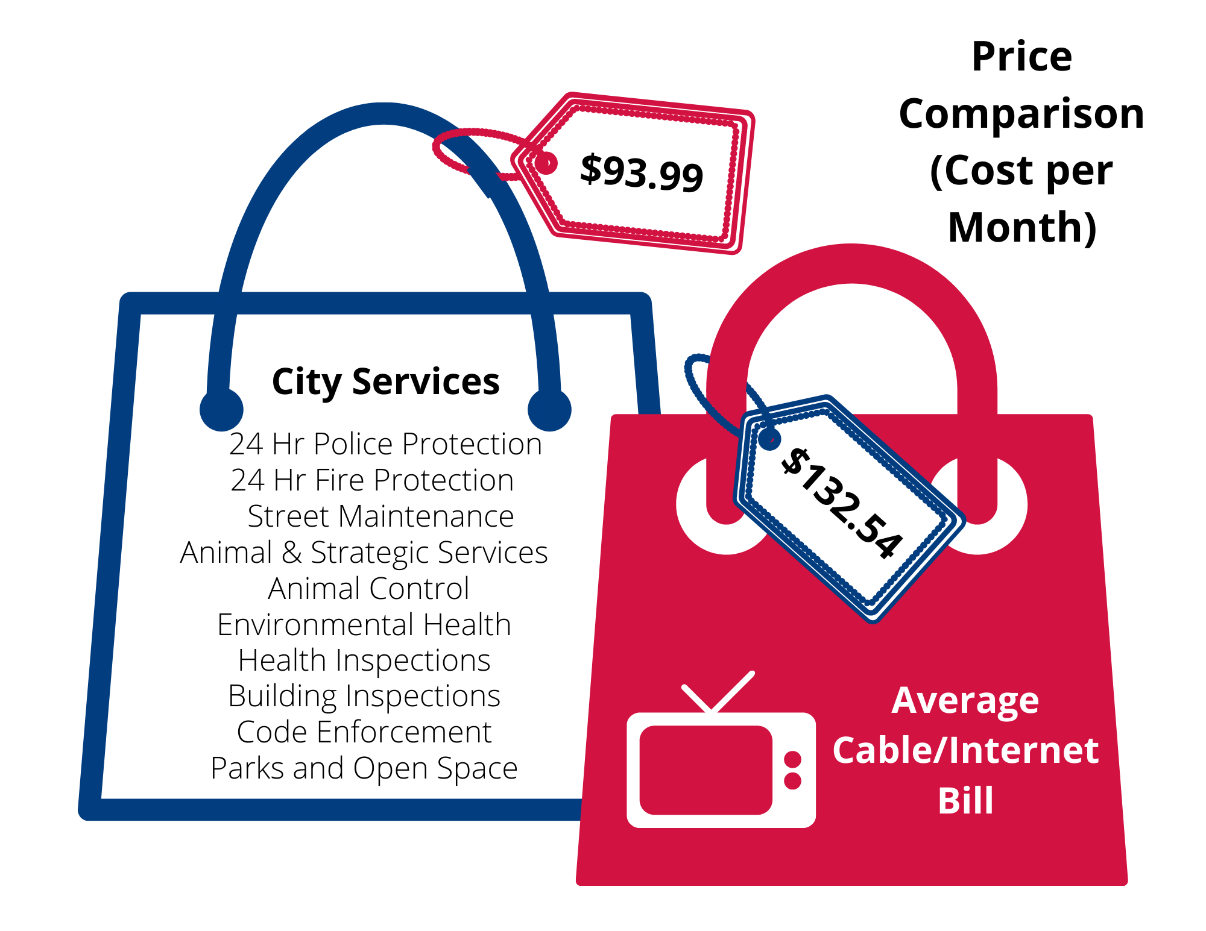
Your General Fund Taxes at a Glance
$81
Cable Bill Comparison

Slide 12
FY22 Budget Factors
Appraised Values up $50 million (10.1%) – Avg Home Value ($141,002)
Proposed FY22 Tax Rate - $0.799976
Proposed Tax Rate Impact in Avg Home Value
FY21 ($. 8216761) - $1158.58
FY22 ($.799976) – 1,127.98 ($30.60 decrease)
GF Surplus – $ 35,500
New Positions
Fire Captain ($96K)
Accountant/UB Supervisor ($65,178)
No Wholesale Utility Rate Increase (NTMWD)
Water Rate Increase (AMI & Northeast Utility Project)
3% Increase = $58,000 (volumetric rate only $7.75 to $7.98)
Residential Impact = $1 increase (assumes 5K consumption)
Sewer Rate Increase (WWTP new operations/sludge)
5% Increase = $34,340 ($5.78 to $5.95) + Fixed Rate increase $1.38
Residential Impact = $2.06

Slide 14
FY22 Budget Update
Sales Tax Projection – 13.2% Increase ($323K)
Sales Tax Street Maintenance Fund ($475,000 … $67K increase)
Sales Tax KEDC ($475,000 … 67K increase)
Adopted Tax Rate = $494K surplus ($.82); $245K ($.79)
Budgeted Park Development Fee - $224K
City Manager Contingency ($30K- GF; $30K – WF)
Step Pay Plan Implementation w/Retention - $220,000
Park Maintenance
$40K Increase
Street Maintenance ($90K)
Sign Replacement($20K)
Health Insurance ($640 PEPM = $531K) – NO INCREASE
City Website Redesign $8,800
Council Chambers Cameras - $10K
Civic Center Holiday Decorations - $25K
ARPA Water Utility Credit - $437,500

Slide 15
Capital Improvement Projects
Tabor Parkway Phase II - $4.5M (Oct Completion)
AMI - $2.6M (9 mth Construction Project)
Storm Drainage Improvements
10th & Clay $1.841M
Hillcrest $458K
Melody Circle $1.172M
Priscilla Lane $370K
Shannon Park $550K
Northeast Utility Project
Street Maintenance
S. Tower Rehab
N. Tower Rehab (CDBG Grant awarded FY23 - $190K match)

Slide 16
STORM DRAINAGE PROJECTS

Slide 17
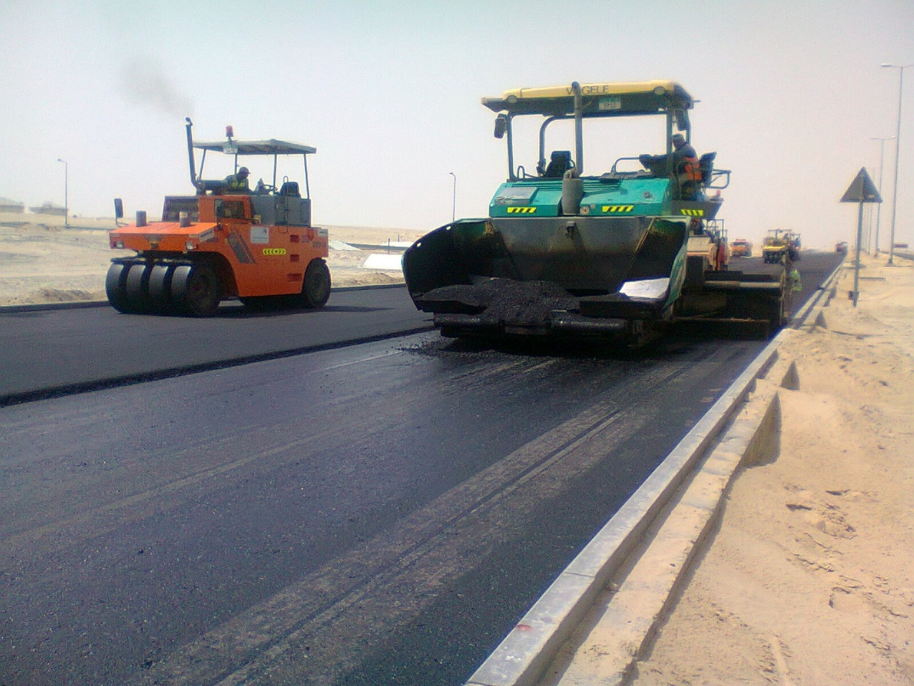
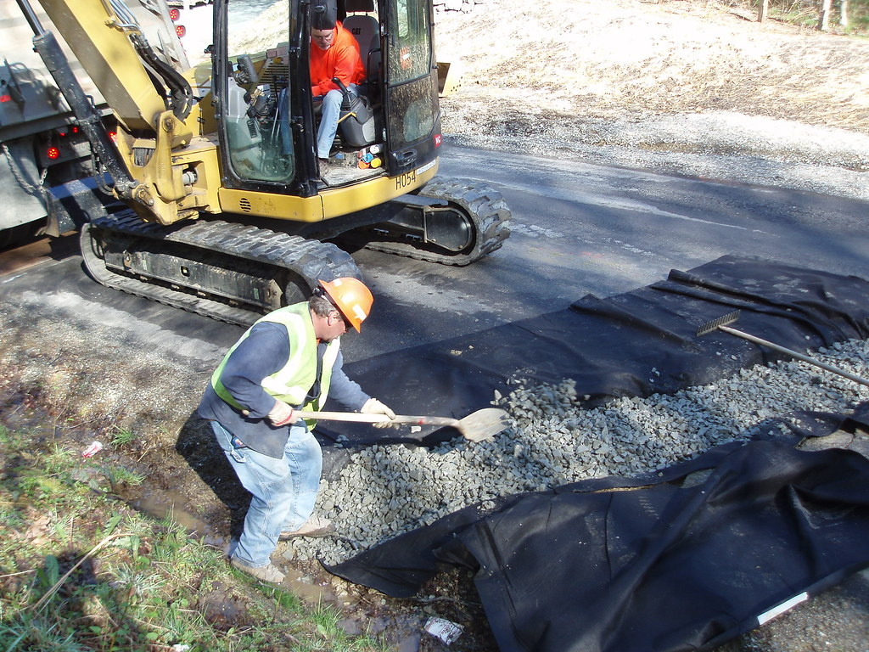
Street maintenance

Slide 18
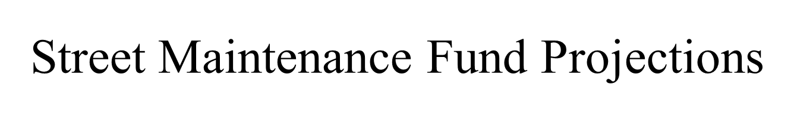

Slide 20
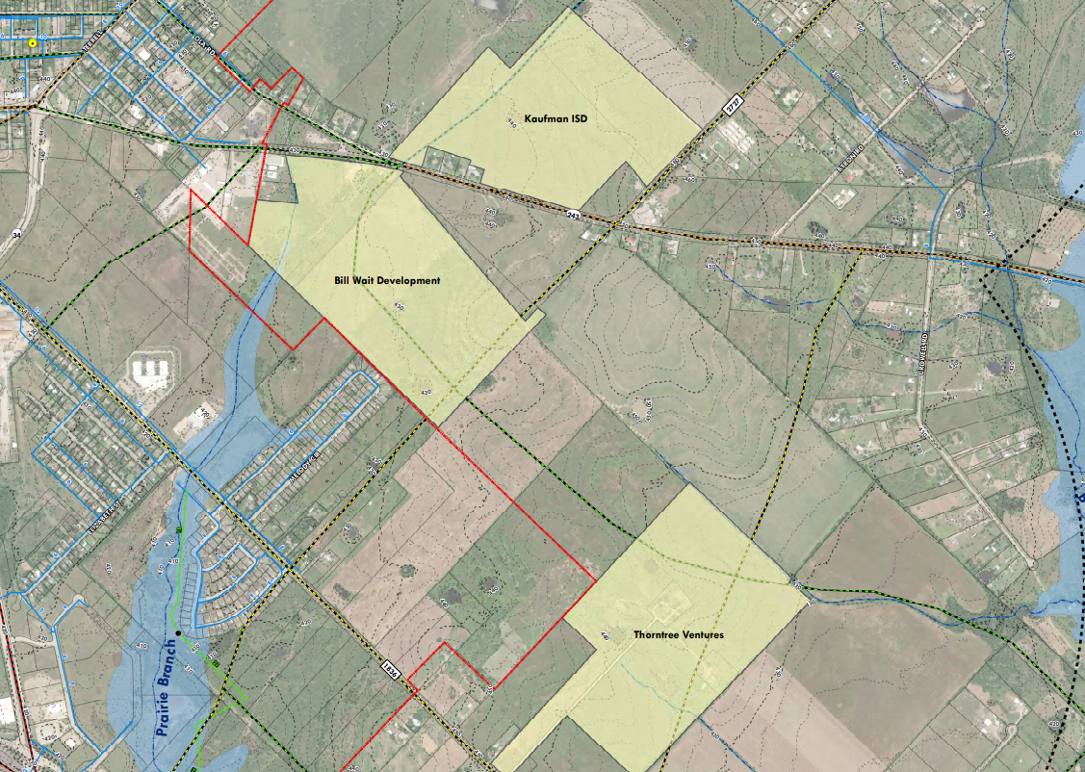
Northeast utility project

Slide 21
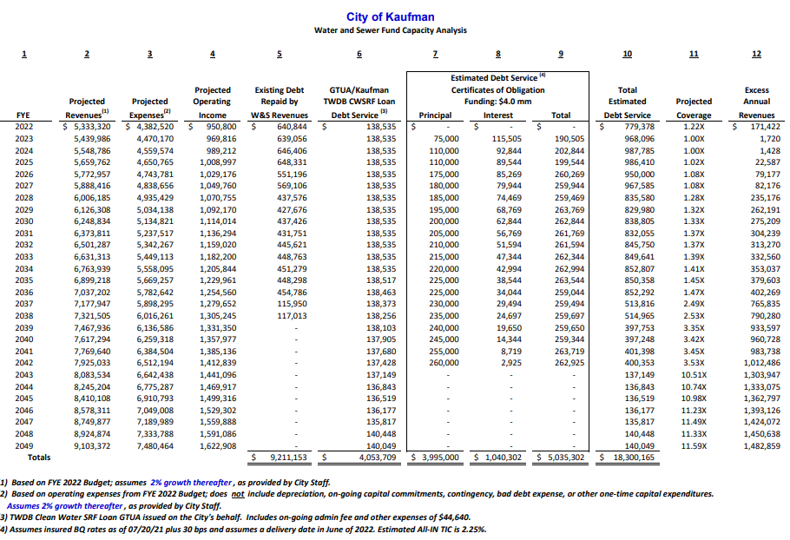

Slide 22
Expected Development – FY22
Marlow’s Convenience Store
Kings Fort Commercial Bldgs (10K sq ft Retail & Urgent Care Clinic)
Lone Star Credit Union
Konnie’s Car Wash
Kings Fort Apartments
Georgetown Single Family Homes (x60)
Oakdale Estates
2 Stand Alone Restaurants
South Pointe Infrastructure

Slide 23
QUESTIONS

